Slide 1
Module 2

Slide 2
ARRAYS
An array is a collection of elements of the same type that are referenced by a common name.
Compared to the basic data type (int, float & char) it is an aggregate or derived data type.
All the elements of an array occupy a set of contiguous memory locations.
Notes:
Agile as opposed to rigorous.

Slide 3
ARRAYS
Why do we need to use array type?
Consider the following issue:
"We have a list of 1000 students' marks of integer type. If we use the basic data type (int), we will declare something like the following…"
int studMark0, studMark1, studMark2, ..., studMark999;
but using an array we can initialize like.....
int studmark[1000]
Notes:
Agile as opposed to rigorous.

Slide 4
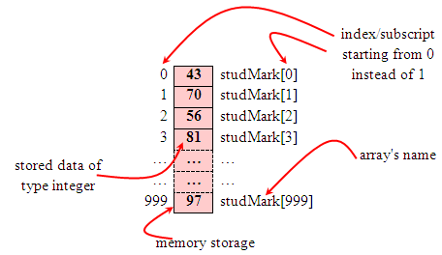
ARRAYS
By using an array, we just declare like this,
int studMark[1000];
Reserves 1000 contiguous memory locations for storing the students’ marks.
Notes:
Agile as opposed to rigorous.

Slide 5
ARRAYS
Simplified our declaration of the variables.
Use index or subscript to identify each element
For example, studMark[0] will refer to the first element of the array.
Subscripts vary from “0” to “number of items in the array -1”
In an array declaration,
int a[10] will hold 10 integer data items/ values and can be accessed
using a[0]…a[9].
a is known as the base address. Address of the first item in an array.
Address of the second item is a+1; here a+1 will be automatically incremented depending on the data type of the array.
Notes:
Agile as opposed to rigorous.

Slide 6
ARRAYS
One Dimensional Array: Declaration
A single or one dimensional array declaration has the following form,
array_element_data_type array_name[array_size];
array_element_data_type defines the base type of the array, which is the type of each element in the array.
array_name is any valid C identifier name that obeys the same rule for the identifier naming.
array_size defines how many elements the array can hold.
Notes:
Agile as opposed to rigorous.

Slide 7
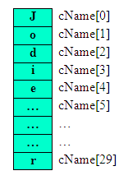
ARRAYS
One Dimensional Array Declaration
For example, to declare an array of 30 characters,
char cName[30];
The array cName can store up to 30 characters with
the first character occupying the location cName[0]
and the last character occupying cName[29].
Note that the index runs from 0 to 29. In C, an index
always starts from 0 and ends with (array's size-1).
Notes:
Agile as opposed to rigorous.

Slide 8
ARRAY DECLARATION EXAMPLES
Examples of one-dimensional array declarations:
int xNum[20], yNum[50];
float fPrice[10], fYield;
char chLetter[70];
The first example declares two arrays named xNum and yNum of type int. Array xNum can store up to 20 integer numbers while yNum can store up to 50 numbers.
The second line declares the array fPrice of type float. It can store up to 10 floating-point values.
fYield is basic variable which shows array type can be declared together with basic type provided the type is similar.
The third line declares the array chLetter of type char. It can store a string with up to 69 characters.
Why 69 instead of 70? Remember, a string has a null terminating character (\0) at the end, so we must reserve space for it.
Notes:
Agile as opposed to rigorous.

Slide 9
ARRAY INITIALIZATION
An array may be initialized at the time of declaration.
Initialization of an array may take the following form:
type array_name[size] = {a_list_of_values};
For example:
int idNum[7] = {1, 2, 3, 4, 5, 6, 7}; // idNum[0]=1, idNum[1]=2
int a[4] = { 1,2}; // a[0]=1,a[1]=2,a[2]=0,a[3]=0
float ft[3] = {5.6, 5.7, 5.8}; // 5.6 to ft [0], 5.7 to ft[1] , 5.8 to ft[2]
char chString[7] = {‘h', ‘i', ‘ ', ‘v', ‘i’, ‘t’, '\0’};
Assigns the characters 'a' to chVowel[0], 'e' to chVowel[1], and so on. Note again, for characters we must use the single apostrophe/quote (') to enclose them.
Also, the last character in chVowel is NULL character ('\0').
Notes:
Agile as opposed to rigorous.

Slide 10
ARRAY INITIALIZATION
Initialization of an array of type char for holding strings may take the following form,
char array_name[size] = "string_literal_constant";
For example, the array chString in the previous example could have been written more compactly as follows,
char char chString[7] = “hi vit”;
When the value assigned to a character array is a string (which must be enclosed in double quotes), the compiler automatically supplies the NULL character but we still have to reserve one extra place for the NULL.
For unsized array (variable sized), we can declare as follows,
char chName[ ] = “Student";
C compiler automatically creates an array which is big enough to hold all the initialized values.
Notes:
Agile as opposed to rigorous.

Slide 11
ARRAY PROCESSING
Array elements are commonly used in loops
E.g.,
for(i=0; i < max; i++) A[i] = i*i;
sum = 0;
for(j=0; j < max; j++) sum += B[j];
for (count=0; rc!=EOF; count++) rc=scanf("%f", &A[count]);

Slide 12
Arrays-summary
Arrays are helpful for storing data using a single name.
Arrays should be declared before using them in the program.
Single dimensional arrays are of different types and their starting index is 0.
During declaration of an array, it is possible to initialize values.
Subscripts help to identify positions of elements in an array.
Loops are used for array processing.

Slide 13
Operations on arrays
(a) To increment the ith element, the given statements can be used.
ar[i]++;
ar[i] += 1;
ar[i] = ar[i] + 1;
(b) To add n to the ith element, the following statements may be used,
ar[i] += n;
ar[i] = ar[i] + n;
(c) To copy the contents of the ith element to the kth element, the following statement may be written.
ar[k] = ar[i];
(d) To copy the contents of one array ‘ar’ to another array ‘br’, it must again be done one by one.
int ar[10],br[10];
for(i = 0; i < 10; i = i + 1)
br[i] = ar[i];

Slide 14
Operations on arrays
(e) To exchange the values in ar[i] and ar[k], a ‘temporary’ variable must be declared to hold one value, and it should be the same data type as the array elements being swapped.
int temp;
temp = ar[i];
/* save a copy of value in ar[i] */
ar[i] = ar[j];
/* copy value from ar[j] to ar[i] */
ar[j] = temp;
/* copy saved value of ar[i] to ar[j] */

Slide 15
Accessing Array Elements
x and y are similar arrays (i.e., of the same data type, dimensionality, and size), then assignment operations, comparison operations, etc., using them should be carried out on an element-by-element basis.
Examples using the elements of an array named ‘numbers’ are shown here:
numbers [0] = 98;
numbers [1] = numbers [0] – 11
numbers [2] = 2 * (numbers [0] – 6);
numbers [3] = 79;
numbers [4] = (numbers [2] + numbers [3] – 3)/2;
total = numbers[0] + numbers[1] + numbers[2] + numbers[3] + numbers[4];

Slide 16
Storing values given by the user in an array
Reading the input into an array is done as shown.
int a[10]; /* an array with 10 “int” elements */
int i;
for(i=0 ; i< 10; i++)
scanf(“%d”, &a[i]);
Eg:
Input: 9 8 7 6 5 4 3 2 1 0
Result:
a[0]=9, a[1]=8 ………. a[9]=0

Slide 17
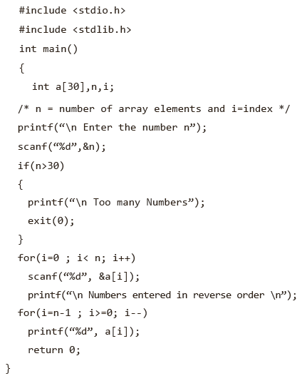
Printing an array
The following code segment prints the elements of an array, a[10].
for(i=0 ; i< 10; i++)
printf(“%d”, a[i]);

Slide 18

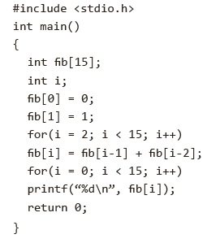
Fibonacci series using an array

Slide 19
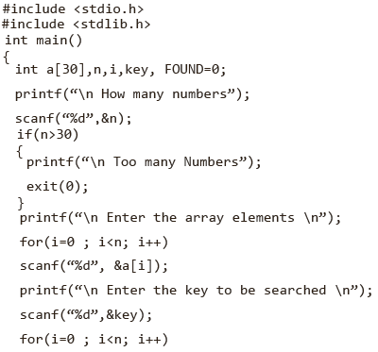
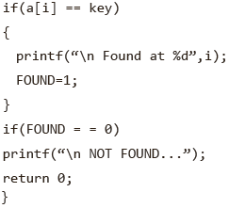
Searching an element within an array

Slide 20
Bubble sort
A bubble sort compares adjacent array elements and exchanges their values if they are out of order.
In this way, the smaller values ‘bubble’ to the top of the array (towards element 0), while the larger values ‘sink’ to the bottom of the array.
This sort continues until no exchanges are performed in a pass.

Slide 21
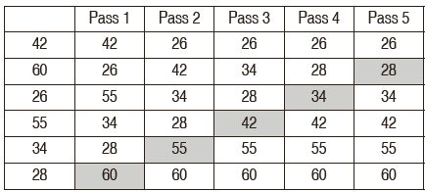
Bubble sort

Slide 22
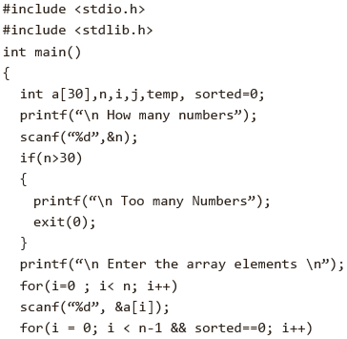
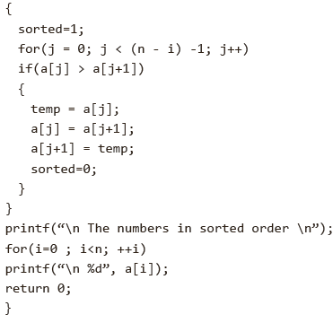
Bubble sort program

Slide 23
MULTIDIMENSIONAL ARRAYS
Arrays with more than one dimension are called multidimensional arrays.
An array of two dimensions can be declared as follows:
data_type array_name[size1][size2];
Here, data_type is the name of some type of data, such as int. Also, size1 and size2 are the sizes of the array’s first and second dimensions, respectively.
A three-dimensional array, such as a cube, can be declared as follows:
data_type array_name[size1][size2][size3]

Slide 24
Cont.
The number of subscripts determines the dimensionality of an array.
E.g. :
x[i] refers to an element of a one-dimensional array, x.
y[i][j] refers to an element of a two-dimensional array, y, and so on.
int b[3][5]={{1,2,3,4,5},{6,7,8,9,10},{11,12,13,14,15}};
Unsized Array Initializations
C compiler automatically creates an array big enough to hold all the initializers. This is called an unsized array.
char e1[] =“read error\n”;
char e2[] =“write error\n”;

Slide 25
Printing matrix element
#include<stdio.h>
int main(){
int i=0,j=0;
int arr[4][3]={{1,2,3},{2,3,4},{3,4,5},{4,5,6}};
for(i=0;i<4;i++){
for(j=0;j<3;j++){
printf("arr[%d] [%d] = %d \n",i,j,arr[i][j]);
}
}
return 0;
}
Output:
arr[0][0] = 1
arr[0][1] = 2
arr[0][2] = 3
arr[1][0] = 2
arr[1][1] = 3
arr[1][2] = 4
arr[2][0] = 3
arr[2][1] = 4
arr[2][2] = 5
arr[3][0] = 4
arr[3][1] = 5
arr[3][2] = 6

Slide 26
Cont.
Multi-dimensional arrays are kept in computer memory as a linear sequence of variables.
The elements of a multi-dimensional array are stored contiguously in a block of computer memory.
The number of subscripts determines the dimensionality of an array.
If unsized arrays are declared, the C compiler automatically creates an array big enough to hold all the initializers.

Slide 27
Matrices (2D-arrays)
A matrix is a set of numbers arranged in a grid with rows and columns.
A matrix is defined using a type declaration statement.
datatype array_name[row_size][column_size];
int matrix[3][4];
4
1
0
2
-1
2
4
3
0
-1
3
1
Row 0
4 | 1 | 0 | 2
-1 | 2 | 4 | 3
0 | -1 | 3 | 1
Row 1
Row 2
Column 0
Column 2
Column 3
Column 1
memory – row major order

Slide 28
Accessing Array Elements
int matrix[3][4];matrix has 12 integer elements
matrix[0][0] element in first row, first column
matrix[2][3] element in 3rd row, 4th column
matrix is the address of the first element
matrix[1] is the address of Row 1
matrix[1] is a one-dimensional array (Row 1)

Slide 29
Initialization
int x[4][4] = { {2, 3, 7, 2},
{7, 4, 5, 9},
{5, 1, 6, -3},
{2, 5, -1, 3}};
int x[][4] = { {2, 3, 7, 2},
{7, 4, 5, 9},
{5, 1, 6, -3},
{2, 5, -1, 3}};

Slide 30
Initialization
int i, j, matrix[3][4];
for (i=0; i<3; i++)
for (j=0; j<4; j++)
matrix[i][j] = i;
matrix[i][j] = j;
j
j
0 1 2 3
0 1 2 3
0
0 | 0 | 0 | 0
1 | 1 | 1 | 1
2 | 2 | 2 | 2
0
0 | 1 | 2 | 3
0 | 1 | 2 | 3
0 | 1 | 2 | 3
i
1
i
1
2
2

Slide 31
Exercise
Write the nested loop to initialize a 2D array as follows:
0 | 1 | 2
1 | 2 | 3
2 | 3 | 4
3 | 4 | 5
Solution:
int i, j, x[4][3];
for(i=0; i<4; i++)
for(j=0; j<3; j++)
x[i][j] = i+j;

Slide 32
2D declarations
/* Valid declaration*/
int abc[2][2] = {1, 2, 3 ,4 }
/* Valid declaration*/
int abc[][2] = {1, 2, 3 ,4 }
/*Invalid declaration – you must specify second dimension*/
int abc[][] = {1, 2, 3 ,4 }
/*Invalid because of the same reason mentioned above*/
int abc[2][] = {1, 2, 3 ,4 }

Slide 33
2D array example: Storing elements in a matrix and printing it.
#include<stdio.h>
int main()
{
int arr[3][3],i,j;
for(i=0;i<3;i++)
{
for(j=0;j<3;j++)
{
printf("Entera[%d][%d]:",i,j);
scanf("%d",&arr[i][j]);
}
}
printf("\n printing the elements....\n");
for(i=0;i<3;i++)
{
printf("\n");
for(j=0;j<3;j++)
printf("%d\t",arr[i][j]);
}
return 0;
}
Output:
Enter a[0][0]: 56
Enter a[0][1]: 10
Enter a[0][2]: 30
Enter a[1][0]: 34
Enter a[1][1]: 21
Enter a[1][2]: 34
Enter a[2][0]: 45
Enter a[2][1]: 56
Enter a[2][2]: 78
printing the elements ....
56 10 30
34 21 34
45 56 78

Slide 34
Maximum element finding
Find the maximum element of the matrix:
int matrix[3][4]
int max =0;
for (i=0; i<3; i++)
for (j=0; j<4; j++)
if (matrix[i][j] > max)
max = matrix[i][j];

Slide 35
Find an item in a Matrix
#include<stdio.h>
int main(){
int m, n, item, count=0, array[5][5];
printf("Enter the number of rows and columns: ");
scanf("%d %d", &m, &n);
printf("Enter %d elements: ", (m*n));
for(int i=0; i<m; i++){
for(int j=0; j<n; j++){
scanf("%d", &array[i][j]);
}}
printf("Enter the item to find: ");
scanf("%d", &item);
for(int i=0; i<m; i++){
for(int j=0; j<n; j++){
if(array[i][j] == item){
printf("Item found at [%d, %d] \n", i, j);
count++;
}} }
if(count==0)
printf("Item Not found");
return 0;
}

Slide 36
Frequency of an element in 2D array
int count = 0;
for (i=0; i<3; i++)
for (j=0; j<4; j++)
if (matrix[i][j] == x)
count = count + 1;

Slide 37
Matrix sum
Compute the addition of two matrices
0 1 2 3
0 1 2 3
0 1 2 3
0
0
1
0
2
0
3
-1
3
1
0
3
0
3
3
1
-1
2
4
3
+
1
1
4
2
0
=
1
0
6
6
3
2
0
-1
3
1
2
2
1
1
3
2
2
0
4
4

Slide 38
Solution
int matrix1[3][4],
matrix2[3][4],
sum[3][4];
// initialize matrix1 and matrix2
for (i=0; i<3; i++)
for (j=0; j<4; j++)
sum[i][j]= matrix1[i][j] + matrix2[i][j];

Slide 39
Transpose
#include <stdio.h>
int main() {
int a[10][10], transpose[10][10], r, c;
printf("Enter rows and columns: ");
scanf("%d %d", &r, &c);
// asssigning elements to the matrix
printf("\nEnter matrix elements:\n");
for (int i = 0; i < r; ++i)
for (int j = 0; j < c; ++j) {
printf("Enter element a%d%d: ", i + 1, j + 1);
scanf("%d", &a[i][j]);
}
// printing the matrix a[][]
printf("\nEntered matrix: \n");
for (int i = 0; i < r; ++i)
for (int j = 0; j < c; ++j) {
printf("%d ", a[i][j]);
if (j == c - 1)
printf("\n");
}
// computing the transpose
for (int i = 0; i < r; ++i)
for (int j = 0; j < c; ++j) {
transpose[j][i] = a[i][j];
}
// printing the transpose
printf("\nTranspose of the matrix:\n");
for (int i = 0; i < c; ++i)
for (int j = 0; j < r; ++j) {
printf("%d ", transpose[i][j]);
if (j == r - 1)
printf("\n");
}
return 0;
}
a
1 | 5 | 3
4 | 2 | 6
b
1 | 4
5 | 2
3 | 6

Slide 40
Matrix multiplication
int a[3][2], b[2][4], c[3][4];
Find c = a * b;
a =
b=
c[0][0] = a[0][0]*b[0][0] + a[0][1]*b[1][0] + a[0][2]*b[2] [0]
c[0][1] = a[0][0]*b[0][1] + a[0][1]*b[1][1] + a[0][2]*b[2][1]
c[1][0] = a[1][0]*b[0][0] + a[1][1]*b[1][0] + a[1][2] *b[2][0]
c[1][1] = a[1][0]*b[0][1] + a[1][1]*b[1][1] + a[1][2]*b[2][1]
1 | 2 | 3
4 | 5 | 6
4 | 5
6 | 7
8 | 9

Slide 41
Matrix Multiplication cont’d
j
j
0 1 2 3
3 | 4
5 | 2
1 | 6
0 1 2 3
22 | 29 | 45 | 35
18 | 40 | 47 | 21
26 | 33 | 43 | 49
0
1
2
2 | 3 | 7 | 1
4 | 5 | 6 | 8
0
1
2
x
=
i
i
j=0
2
4
i=0
3 | 4
x
k
=
c[i][j] = a[i][k=0]*b[k=0][j]+a[i][k=1]*b[k=1][j]
k

Slide 42
Matrix Multiplication cont’d
#define N 3
#define M 2
#define L 4
void matrix_mul(a[N][M], int b[M][L], int c[N][L])
{
int i, j, k;
for(i=0; i < N; i++) {
for(j=0; j < L; j++) {
c[i][j] = 0;
for(k=0; k < M; k++) {
c[i][j] = c[i][j] + a[i][k] * b[k][j];
}
}
}
return;
}

